Slide 1
POWER BI DEPLOYMENT

Slide 2
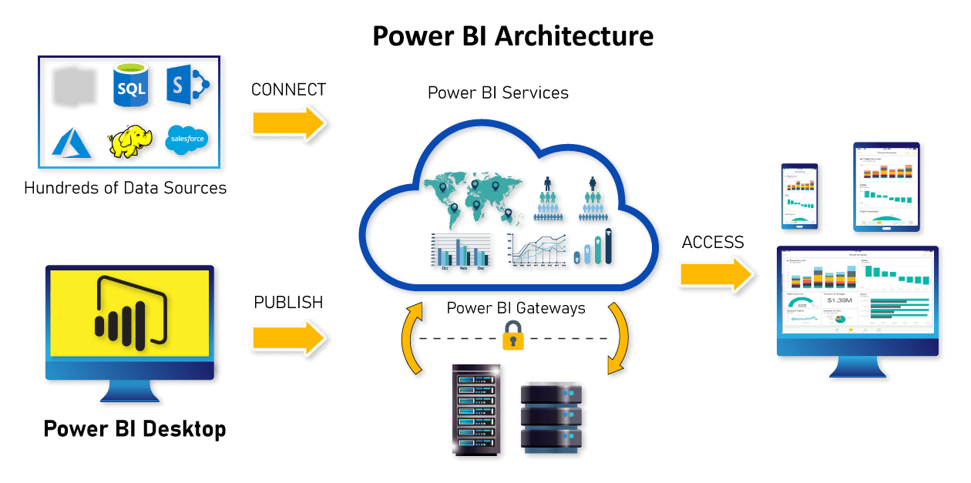
POWER BI DEPLOYMENT Power BI deployment means moving the power bi desktop report to Power BI Services (Power BI Web) so that it can be accessed by web and mobile application through secured credentials.

Slide 3
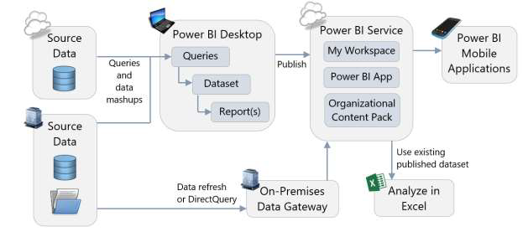
POWER BI REPORT PUBLISHING

Slide 4
WEB VERSIONS SUPPORTS THREE TYPES OF ACCOUNTS
DESKTOP | WEB VERSION
PBIX | URL THE DESKTOP REPORT IS CONVERTED INTO URL WHICH CAN BE SHARED WITH DIFFERENT USERS
Desktop is completely free | Web version have free and pro accounts
Web account can be on Microsoft cloud or it can on the domain of the company
FREE | PRO | PREMIUM
Cloud | On Premises
Data & Report will be stored on Microsoft cloud server and will be managed by Microsoft team | Microsoft Power BI web services will be hosted on in house servers and will be managed by the company

Slide 5
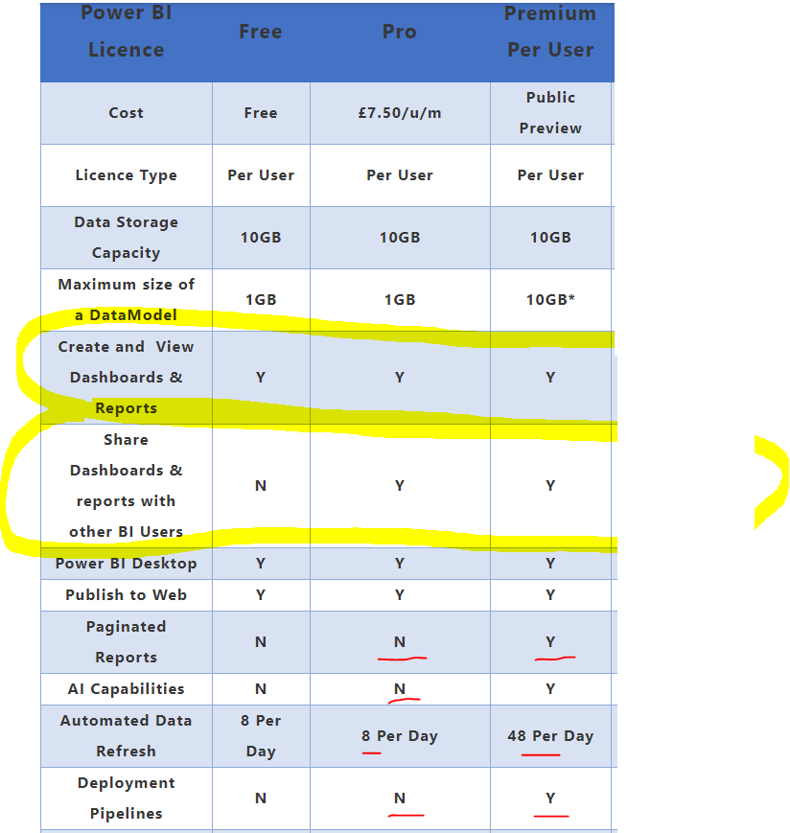

Slide 6
Capacity-based Licensing
These are offered in two categories;
Power BI Embedded
Power BI Premium
Each of the above options has different SKU and pricing levels and tiers. The main important thing is that the capacity-based licensing options cannot be used alone; you need to combine them with a user-based license. For example, you will need a Power BI Pro license for the developer hosting the Power BI reports in a workspace under a Power BI Premium capacity.
Power BI Embedded
If you ever want to embed Power BI content in a custom application and use a custom application’s user management, then Embedded is the licensing plan for you.
Power BI Premium
In Power BI premium, you pay for nodes that have dedicated capacity and resources
This is perhaps the most significant advantage of the Premium capacity license over PPU. Suppose you have the Power BI content hosted in a workspace. If your workspace is a premium workspace (connected to a premium capacity), then you can create an app on the workspace and share the workspace’s content through that app with the end-users. End-users won’t need paid Power BI licenses to consume the content. They can have a Power BI Free account. In other words, a Power BI report hosted in a Premium-capacity workspace can be shared with thousands of free Power BI account holders.
https://azure.microsoft.com/en-us/pricing/details/power-bi-embedded/

Slide 7
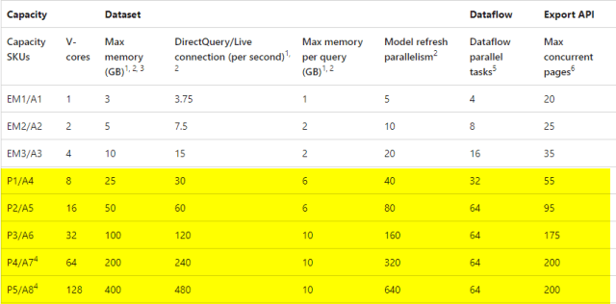
https://azure.microsoft.com/en-us/pricing/calculator/?service=power-bi-embedded

Slide 8
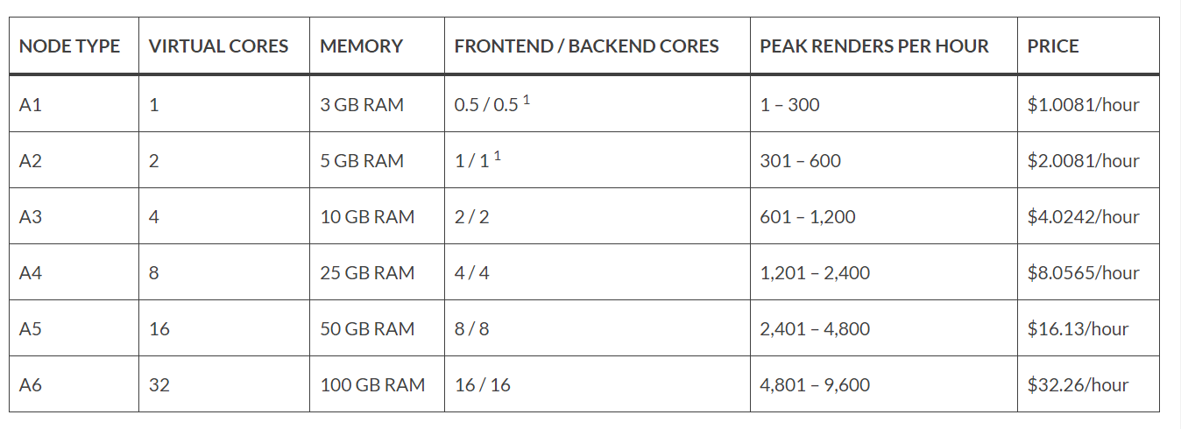

Slide 9
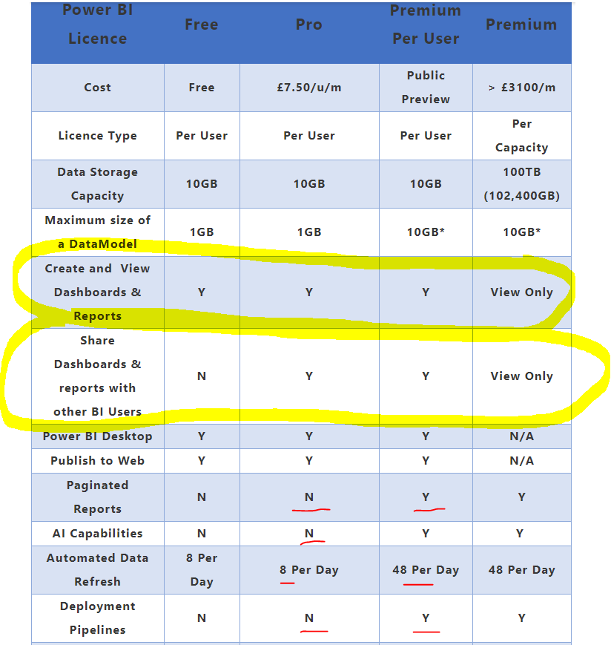

Slide 10
POWER BI SERVICES COMPONENTS / FEATURES
COMPONENTS | REPORTS FEATURES | SECURITY FEATURES
WORKSPACE REPORTS DASHBOARD DATASETS GATEWAY | EDITING POWER BI REPORT EXPORTING POWER BI REPORTS EMBEDDED POWER BI URLS DATA REFRESH SCHEDULED REFRESH SHARING POWER BI REPORTS POWER BI SUBSCRIPTIONS | WORKSPACE SECURITY REPORT LEVEL SECURITY ROW LEVEL SECURITY

Slide 11
POWER BI SERVICES COMPONENTS
Workspace
A workspace is a folder which stores the reports.
Report
A Report is PBIX report which is moved from Desktop to Power BI Web Apps.
Dashboard
A Dashboard is a summary page of Power BI Reports which is created from the visualization of Power BI Reports.
Datasets
Gateway
A Dataset is the data associated with the Power BI Reports
A gateway is the bridge between the local sources machine and the dataset in the Report, which should be always on the local machine to refresh the datasets.

Slide 12
POWER BI SECURITY FEATURES
Workspace Security
Workspace security is applied on the workspace which can be shared with other users to share the workspace with permissions set on it.
Report Security
Report level security is applied on the report level while sharing the report with users.
Row Level Security
Row Level Security is used to apply security at the data level based upon different roles.

Slide 13
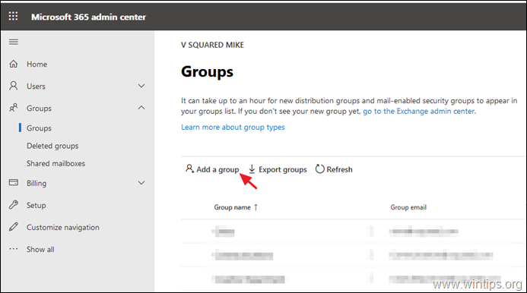

Slide 14
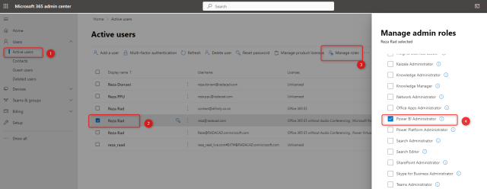

Slide 15
POWER BI Advanced Features
GetData
Power BI Get Data is used to pull data from different sources and create DataSets in Power BI Services which can used in Power BI DeskTop & Web
DataFlows
Power BI Data Flow is the data transformation component in Power BI. It is a Power Query process that runs in the cloud, independent from Power BI report and dataset, and store the data into CDM: Common Data Model inside Azure Data Lake storage.
Power BI app
Deployment Pipeline
Power BI App is a way of sharing content with end users. An app is a Power BI content type that combines related dashboards and reports, all in one place. An app can have one or more dashboards and one or more reports, all bundled together.
Deployment Pipelines allows you to configure different stages of deployment in your pipeline. Deployment Pipelines will also provide you a clear overview of all your stages in one place.

Slide 16
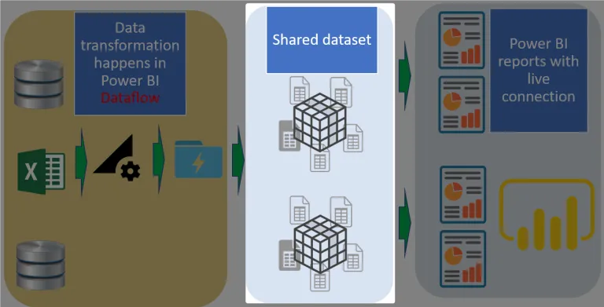
Power BI Get Data(Datasets) is the layer of all the calculations and modeling. It will get data sources or dataflows, and build an in-memory data model using Power BI (Analysis Services) engine. is the data transformation component in Power BI.

Slide 17
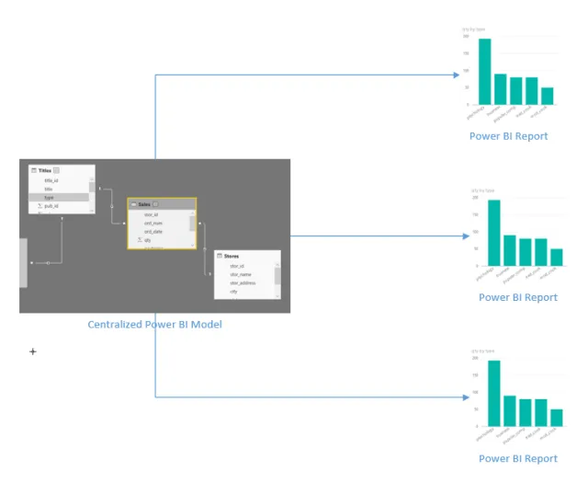
Power BI GetData solves the problem of having multiple versions of the same DAX code in different PBIX files. Using a shared dataset, you can have multiple reports using the same calculations and data model, without duplicating the code;

Slide 18
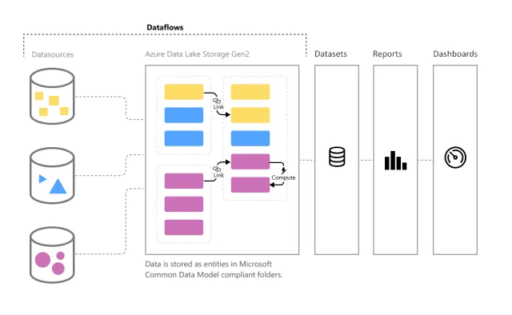
Power BI Dataflow is the data transformation component in Power BI. It is a Power Query process that runs in the cloud, independent from Power BI report and dataset, and store the data into CDM: Common Data Model inside Azure Data Lake storage.

Slide 19
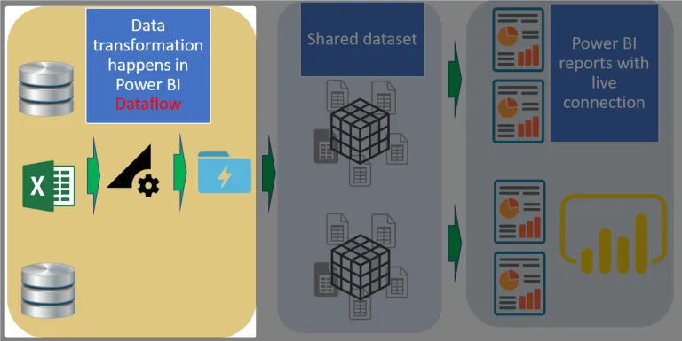
Dataflow is the ETL Layer Dataflow is the Data Transformation layer in your Power BI implementation. The terminology for this layer is ETL (Extract, Transform, Load). This will extract data from data sources, transform the data, and load it into the CDM.

Slide 20
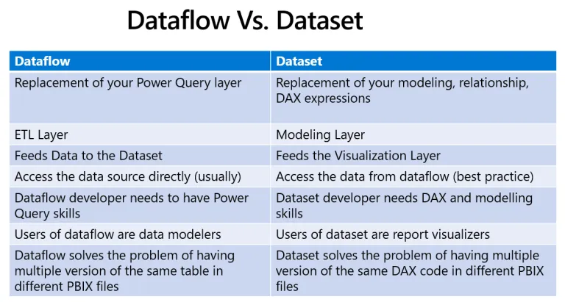
Power BI Data Flow vs Dataset

Slide 21
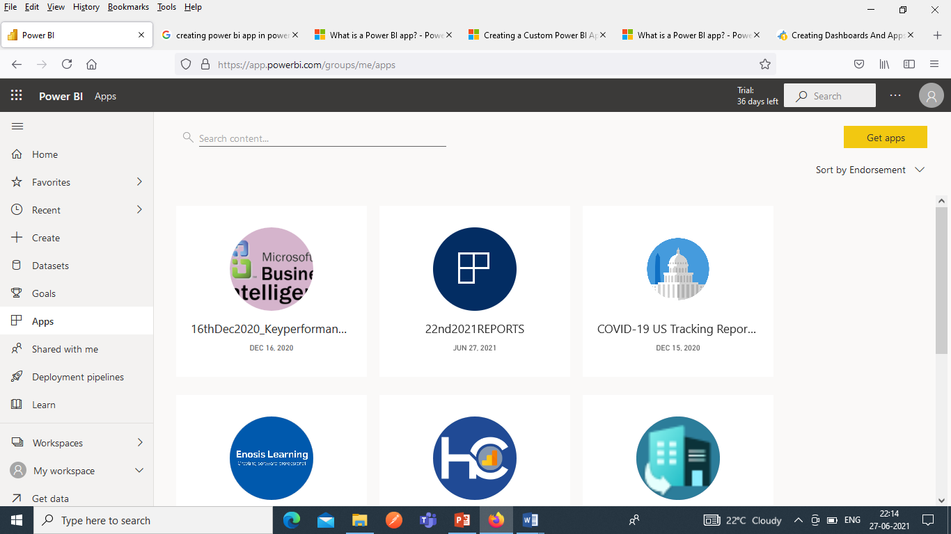
Power BI App is a way of sharing content with end users. An app is a Power BI content type that combines related dashboards and reports, all in one place. An app can have one or more dashboards and one or more reports, all bundled together. In Power BI we can publish apps and get app in Power BI from different sources.

Slide 22
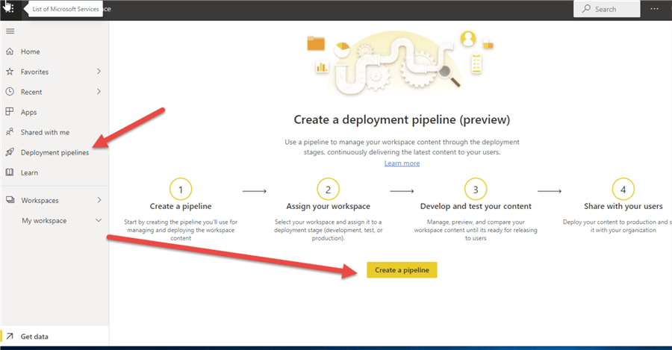
Power BI Deployment Pipeline Deployment Pipelines allows you to configure different stages of deployment in your pipeline. Deployment Pipelines will also provide you a clear overview of all your stages in one place.

Slide 23
POWER BI REPORT FEATURES
FEATURE | DESCRIPTION
EDITING POWER BI REPORT
EXPORTING POWER BI REPORTS
EMBEDDED POWER BI URLS
DATA REFRESH & SCHEDULED REFRESH
SHARING POWER BI REPORTS
POWER BI SUBSCRIPTIONS
POWER BI ALERTS
POWER BI GETDATA

Slide 24
POWER BI SECURITY FEATURES
FEATURE | DESCRIPTION
WORK SPACE SECURITY
REPORT LEVEL SECURITY
ROW LEVEL SECURITY

Slide 25
THANK YOU References

